Slide 1

EuPA initiative for Proteomics Bioinformatics
Meeting 12.11.15 - Agenda

Slide 2
Agenda
1- Communication
2- Kick-off Meeting
3- Other Meetings
4- Funding
5- ToDo
Aim: max 45 min

Slide 3
Communication
New Means of communication:
- Site: will be hosted in GitHub with all the documentation in a EuPA bioinfo organization: github.com/eupa-bioinfo
- Meeting calls: Google hangouts
- Communication on development and contributions: Gitter
- Forum/list: https://groups.google.com/forum/#!forum/eupa-bioinfo
A Google calendar will be set up and integrated to the other resources.
Educational: www.proteomics-academy.eu

Slide 4
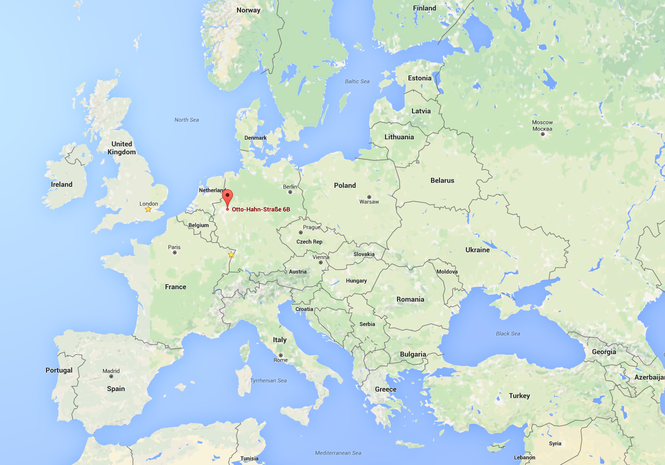
Kick-off Meeting
Leibniz-Institut für
Analytische Wissenschaften (ISAS) www.isas.de
Otto-Hahn str. 6B
Dortmund, Germany
Amsterdam Airport
Düsseldorf Airport
Köln-Bonn Airport
Frakfurt Airport

Slide 5
Agenda
Tentative agenda:
1- Introduction and get to know
2- Working groups
-> Funding
-> Publications
-> Meeting
3- Communication
-> Websites

Slide 6
Other Meetings
Mark your agenda!
1- EuPA in Istambul
-> Bioinformatics Bazaar
2- HUPO in Taipei
-> Bioinformatics Hub
3- Our Conference?
-> Funding needed!

Slide 7
Funding
Possible funding sources
1- National
-> Talk around you
2- European
-> EMBO rejected
3- Crowd Sourcing
-> Let’s get started!

Slide 8
ToDo
For next time…
1- Communication
2- Meetings
3- Funding

Slide 9
EuPA initiative for Proteomics Bioinfromatics
Danke schön! Dank u wel! Mange tak! Merci! Grazie! Takk! Спасибо! Muchas Gracias! Thank you!

